Slide 1
The Evolution of Music Through Technology
Team Name: Code Crafters

Slide 2
Introduction
Music is a universal form of expression across all cultures
Technology has transformed how music is:
Created
Recorded
Distributed
Consumed
Innovations have made music more accessible worldwide
Today, anyone with a smartphone can create, edit, and share music globally

Slide 3

Ancient Era
Early music used natural and handmade instruments:
Drums (animal skins)
Flutes (bones and wood)
Music was passed orally (no written notation)
Played a key role in:
Religious rituals
Tribal communication
Celebrations and storytelling
Strong connection with culture, traditions, and nature

Slide 4
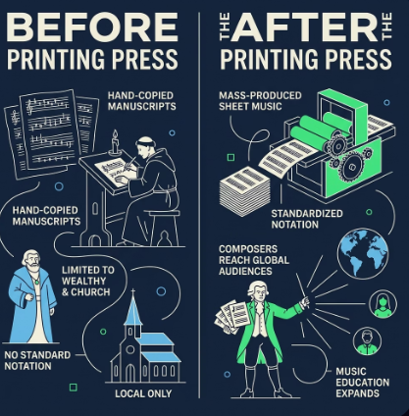
Printing Press Era (15th Century)
Printing press enabled mass production of music materials
Helped in spreading music widely
Uses in Music:
Printing and distributing sheet music
Standardizing musical notation
Helping composers share their work
Making music accessible to more people
Impact:
Music books sold across regions
Easier learning for musicians
Growth in music education and global exchange

Slide 5
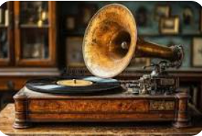
Phonograph & Radio Era (Late 1800s–1950s)
First time music could be recorded and replayed
Reduced dependence on live performances
Key Changes:
Music listening at home became common
Radio enabled mass broadcasting
Music and news reached large audiences
Examples:
Phonograph by Thomas Edison
Early radio broadcasting stations
Impact:
Introduced mass communication
Made entertainment widely accessible

Slide 6
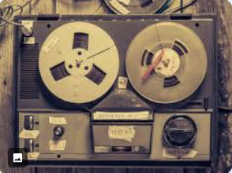
Magnetic Tape & Vinyl Records
Vinyl Records:
Analog discs played using a stylus
Known for high-quality “warm” sound
Popular for albums and distribution
Limitations: fragile, limited duration
Magnetic Tape:
Stores audio as magnetic signals
Used in cassettes and reel systems
Enabled recording, editing, and re-recording
Portable and widely used
Impact:
Enabled mass music production
Introduced multi-track recording
Allowed personal recordings (mixtapes)

Slide 7

Cassette & Walkman (1970s–80s)
Cassette Tape:
Compact device with magnetic tape
Used for storing and recording audio
Introduced by Philips
Walkman:
Portable cassette player by Sony (1979)
Enabled personal listening with headphones
Impact:
Made music personal and portable
Increased popularity among youth

Slide 8

CDs & Digital Audio (1990s)
Shift from analog to digital music
Compact Discs (CDs) became popular
Features:
High-quality, noise-free sound
Instant track selection
Storage up to ~700 MB (~80 minutes)
More durable than cassettes
Impact:
Replaced cassettes and vinyl
Boosted global music sales
Encouraged digital production
Conclusion:
Laid foundation for MP3 and streaming

Slide 9
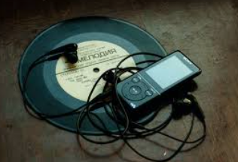
Internet & MP3 (2000s)
Music became fully digital
Easy online access and sharing
Key Changes:
Download and share songs online
Store thousands of songs in one device
Access music anytime via internet
Examples:
Napster (file sharing)
Apple iPod (portable music storage)
iTunes Store (online music purchase)
Impact:
Reduced use of CDs
Made music portable and convenient

Slide 10

Streaming Era (2010s)
Music available instantly via internet
No need to download or store files
Features:
Access millions of songs anytime
Multi-device support
Personalized recommendations
Offline listening options
Examples:
Spotify
YouTube Music
Impact:
Faster and easier access to music
Highly personalized listening experience

Slide 11
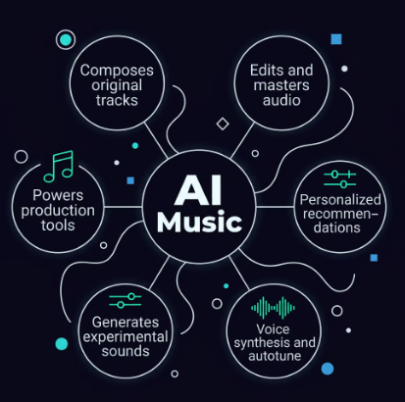
AI and Modern Music
Artificial Intelligence is transforming music
Uses of AI:
Composing songs and melodies
Personalized music recommendations
Voice enhancement (autotune, synthesis)
Assisting in music production
Examples:
Spotify and YouTube recommendations
AI-generated music tools
AI-assisted sound design
Impact:
Enhances creativity
Improves user experience
Opens new possibilities in music creation

Slide 12
Future of Music Technology
Future Trends:
Virtual Reality (VR) concerts
Hologram performances
Advanced AI-generated music
Personalized listening experiences
Interactive and immersive music
Conclusion:
Music evolved from simple instruments to digital platforms
Technology improved creation and accessibility
Every era transformed how we experience music
Future innovations will continue to reshape music

Slide 13
Thank You

